Slide 1
Refugees, Refugee Claimants and Access to Care
Dr. Gillian Morantz
Pediatrician, MCH
MUHC Health Equity Symposium

Slide 2
Outline
Immigration categories
Challenges in accessing healthcare
Health issues
Proposed solutions

Slide 3
Immigration categories

Slide 4
Displaced persons
Resettled refugee
Forced to flee country
Conflict, persecution, violence, violations of human rights
Accepted as refugee before arriving in Canada
Refugee Claimant
Enters country by own means and makes refugee claim at border or within Canada
Undergoes quasi-judicial process to determine if claim is accepted
Immigrant
Voluntary resettlement in another country
E.g. for work purposes, reunite with family members
Notes:
Preface: it’s important to understand all the different terms for immigrants and refugees, not only because of the implications for health and social insurance coverage, but also so that we are respectful and informed in our care for these children.
Took out permanent residency in canada – can be confusing when talking about permanent residents…
Fear of persecution (race, religion, nationality, political opinion, particular social group)
Took out Convention and protection by Canada
Immigrants might move under duress as well – not forced as in convention refugee definition

Slide 5
Immigration status
Immigrant
(permanent resident)
(85%)
Humanitarian
(10%)
Resettled refugee (permanent resident)
Temporary status (student, visitor, temporary workers)
(5%)
Refugee Claimant
(asylum seeker)
Government assisted refugee (GAR)
Privately sponsored refugee
Non-status
(?)
Accepted refugee (permanent resident)
Rejected
Notes:
It is helpful for health care providers to understand how Citizenship and Immigration Canada (CIC) classify children and youth new to Canada.
Each group or category faces unique challenges in terms of process and access to health care funding.
The majority of newcomers to Canada are immigrants. These are individuals who choose to resettle in Canada for reasons such as economic opportunities or to join family members.
A minority of newcomers to Canada are refugees. These are individuals who are forced to flee because of persecution and who seeks safety outside of their home country.
Non-status are those individuals who have no legal status in Canada. They include those who have entered Canada illegally, rejected refugee claimants who have stayed beyond their date of deportation and temporary visitors who have stayed after their visas have expired.
This module will focus on the unique health issues of refugees, who make up 10% of newcomers to Canada. (MCQ #4 ANSWER)
Sources:
Graph adapted from Osmalliu et al, “Providing Care for Kids New to Canada”, Montreal Children’s Hospital Pediatric Grand Rounds, March 9, 2016
Canadian Council for Refugees, Refugees and Immigrants: A glossary, 2010, http://ccrweb.ca/en/glossary
Caring for Kids New to Canada, June 2016, “Health Insurance for Immigrant and Refugee Families”
http://www.kidsnewtocanada.ca/care/insurance

Slide 6
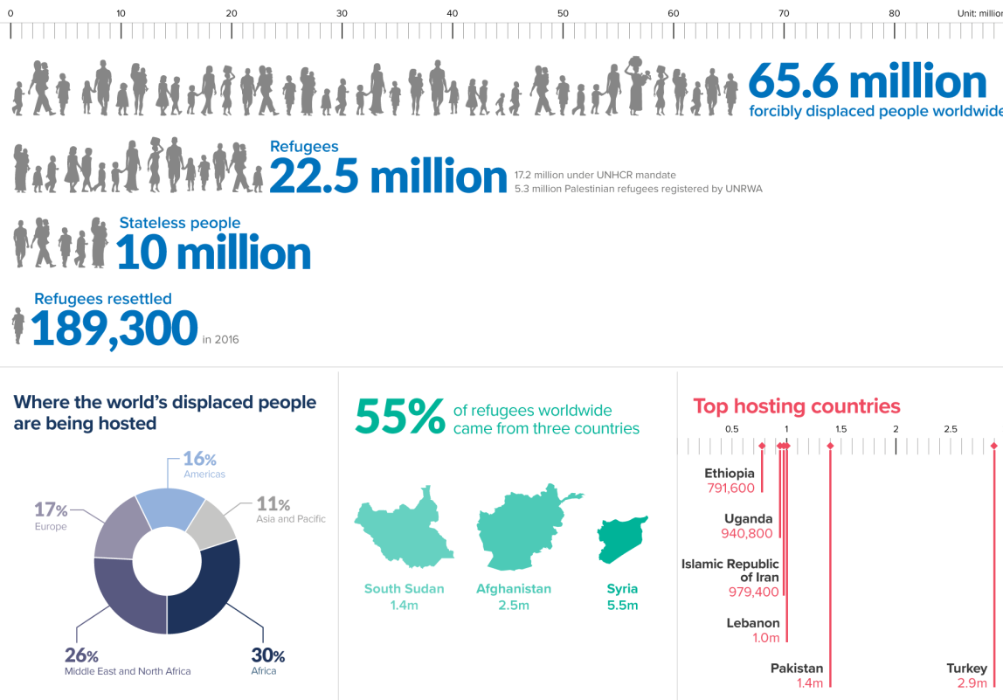
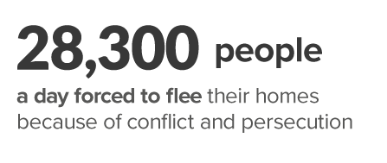
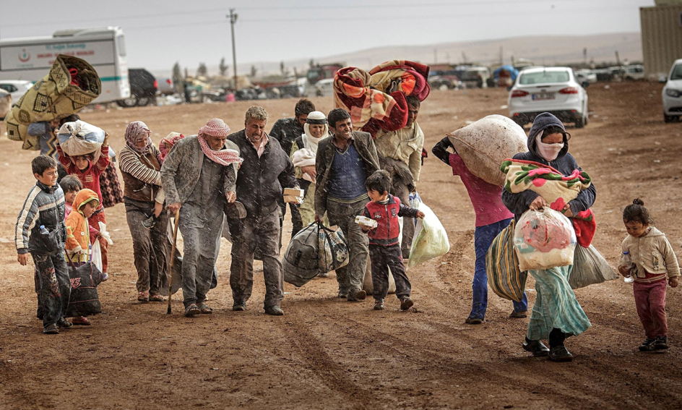
Forced Migration
http://www.unhcr.org/figures-at-a-glance.html
Photo credit: Zohra Bensemra

Slide 7
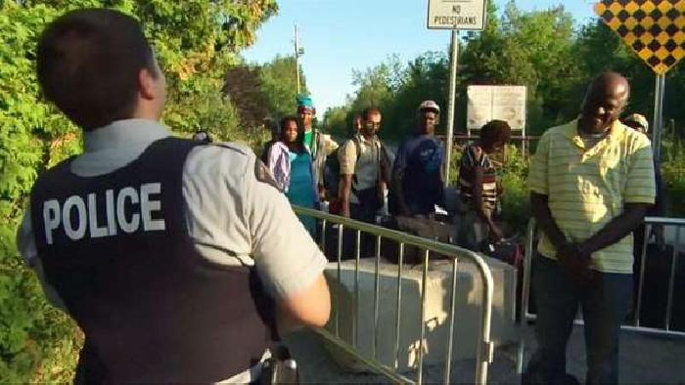
New Refugee Claimants, Quebec 2017
Month | Numbers
AUGUST 2017 | 2734
JULY 2017 | 1674
JUNE 2017 | 798
MAY 2017 | 776
APRIL 2017 | 720
MARCH 2017 | 793
FEBRUARY 2017 | 329
JANUARY 2017 | 299
Countries of Origin
Haiti
Nigeria
Turkey
Saudi Arabia
Brazil
http://www.ciusss-centreouestmtl.gouv.qc.ca/en/ciusss-west-central-montreal/media/praida-2017/#c46992
http://video.newsserve.net/700/v/20170804/1708040105-Haitian-Refugees-Flee-to-Canada-Avoiding.jpg

Slide 8
Claiming refugee status is a long process…
Immigration and refugee Board
(6 wks to 1 yr)
Presentation at local CIC office
Hearing (1-4 yrs)
Interview
Notes:
The refugee claim process is a long one.
Refugee claimants have to undergo a refugee hearing by the Immigration and Refugee Board (IRB) to determine whether their claim for refugee status is accepted.
The IRB is a federal government institution.
Although changes have been made in recent years to streamline the process, refugee claimants wait for several months-years for their hearings. One study showed the average wait time between a refugee claim and hearing was 18 months. 18 months is a long time in the life of a child.
During this wait time, refugee claimants live in uncertainty as to whether they will be able to stay in Canada.
Source:
Canadian Council for Refugees, 2012 “The Experience of Refugee Claimants at Refugee Hearings at the Immigration and Refugee Board.”
http://ccrweb.ca/files/irb_hearings_report_final.pdf
8

Slide 9
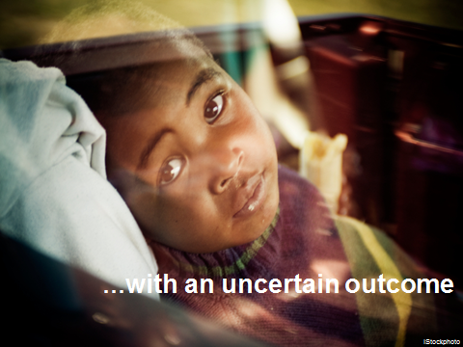
…with an uncertain outcome
iStockphoto
Notes:
Only some refugee claimants are granted refugee status.
Years of waiting for an uncertain outcome can lead to:
feelings of anxiety and ambiguity about investing in a new life.
social/economic vulnerability.
emotional and logistical stressors for families (i.e., access schooling, language, health care).
Source: Children and Youth New to Canada: A Health Care Guide. CPS. 1999.

Slide 10
Challenges to accessing healthcare

Slide 11
Intrinsic barriers to care for children and youth new to Canada
Traumas witnessed
Negative past experience of
health “system”
Personal beliefs
Literacy
Notes:
11
Even when health care programs and funding are available, there may be other barriers to access for new Canadian children and families.
Traumas: child soldiers, refugee camps, rape, violence, war, extreme poverty
Negative experiences: mistrust or lack of confidence in health care system (e.g., corruption)
Personal beliefs: folk medicine, traditional medicine, shamanism
11

Slide 12
Extrinsic barriers to care for children and youth new to Canada
No support systems
Discrimination
Poverty
Traumas witnessed
Negative past experience of
health “system”
Personal beliefs
Literacy
Health insurance!!???!!
Culture shock
Language
Unpreparedness
of host country
Notes:
12
There are also multiple extrinsic barriers to accessing care here for new Canadians.
A multifactorial approach to care is essential.
We should be mindful of their needs and reduce systemic/practice barriers wherever possible.
(MCQ#10 ANSWER)
We are unprepared as hosts to receive this population in that we:
are unfamiliar with prevalent diseases and important health issues.
lack infrastructure such as interpreters and cultural brokers.
Ask (if time permits) about the consequences of:
discrimination (decreasing self-esteem, depression, behavior problems/aggressivity), and
“acculturation”—the process of change in the culture of origin with the exposure of the new culture.
12

Slide 13
What about health insurance?
Provincial health coverage:
For permanent residents (immigrants and resettled refugees)
B.C., Ontario, Quebec, Manitoba have a minimum 3-month waiting period (except for GARs)
Interim Federal Health Program (IFHP):
Refugee claimants
Supplemental coverage for resettled refugees: medication and supplemental services (e.g. dental, vision)
Many who are entitled lack knowledge, documentation or means to secure coverage effectively
Only some specialized clinics provide care without a provincial/territorial health card
“Non-status children” have no health care coverage
Notes:
There are different kinds of health coverage for resettled refugees, refugee claimants and immigrant claimants.
Immigrants to several Canadian provinces have a 3-month wait after they are accepted into Canada until they get provincial/territorial health coverage.
Refugee claimants are covered by the IFHP. They may be denied access to care or charged fees by health clinics unfamiliar with this unique type of health insurance.
There have been recent changes in what the IFHP covers, so you keep yourself informed about it and become a registered IHFP provider.
In several cities across Canada, there are a number of health clinics who specialize in providing care for refugees and immigrants, and some that will provide free care for those without health insurance.
Sources: Caring for Kids New to Canada, June 2016, “Health Insurance for Immigrant and Refugee Families”
http://www.kidsnewtocanada.ca/care/insurance
Osmalliu et al, “Providing Care for Kids New to Canada”, Montreal Children’s Hospital Pediatric Grand Rounds, March 9, 2016

Slide 14
Immigration status
Immigrant
(permanent resident)
(85%)
Provincial (may be delay)
Humanitarian
(10%)
Resettled refugee
(permanent resident)
Provincial & IFHP
Temporary status (student, visitor, temporary workers)
(5%)
Refugee Claimant (asylum seeker)
IFHP
Government assisted refugee (GAR)
Privately sponsored refugee
Non-status
(?)
Accepted refugee (permanent resident)
Provincial & IFHP
Rejected
Notes:
It is helpful for health care providers to understand how Citizenship and Immigration Canada (CIC) classify children and youth new to Canada.
Each group or category faces unique challenges in terms of process and access to health care funding.
The majority of newcomers to Canada are immigrants. These are individuals who choose to resettle in Canada for reasons such as economic opportunities or to join family members.
A minority of newcomers to Canada are refugees. These are individuals who are forced to flee because of persecution and who seeks safety outside of their home country.
Non-status are those individuals who have no legal status in Canada. They include those who have entered Canada illegally, rejected refugee claimants who have stayed beyond their date of deportation and temporary visitors who have stayed after their visas have expired.
This module will focus on the unique health issues of refugees, who make up 10% of newcomers to Canada. (MCQ #4 ANSWER)
Sources:
Graph adapted from Osmalliu et al, “Providing Care for Kids New to Canada”, Montreal Children’s Hospital Pediatric Grand Rounds, March 9, 2016
Canadian Council for Refugees, Refugees and Immigrants: A glossary, 2010, http://ccrweb.ca/en/glossary
Caring for Kids New to Canada, June 2016, “Health Insurance for Immigrant and Refugee Families”
http://www.kidsnewtocanada.ca/care/insurance

Slide 15
Interim Federal Health Program (IFHP)
Significantly cut in June 2012, restored in April 2016
Rhetoric questioning their legitimacy/deservingness
Provides limited, temporary health-care
What?
Medical, diagnostic, hospital services
Medications (+antiparasitic/antiprotozoal meds, vitamins)
Some supplemental services (emergency dental, eye exams, psychotherapy, rehab, prosthetics, orthotics, home care, etc.)
http://www.cic.gc.ca/english/refugees/outside/arriving-healthcare.asp
Chase et al, 2017: The gap between entitlement and access to healthcare: An analysis of “candidacy” in the help-seeking trajectories of asylum seekers in Montreal, Social Science and Medicine
Notes:
For essential and emergency services
Generally similar coverage to RAMQ in terms of
Some supplemental services similar to what people get when on social assistance

Slide 16
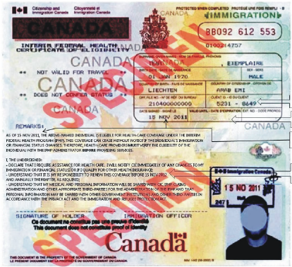
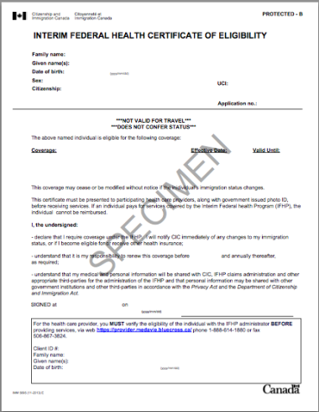
Health Insurance

Slide 17
Barriers to Health Care: IFHP
Telephone survey of walk-in clinics (2014)
Proportion of clinics charging a fee or turning away patients with full IFHP coverage
Montreal: 45%
Toronto: 47%
Conclusion: Coverage ≠ Access
-> Confusing and cumbersome to healthcare providers and beneficiaries
-> Feelings of social and political marginality
-> Stigmatizing & disempowering: decreased help-seeking
Caudarella, A, Hanley, J, Redditt, V, Evans, A, Glazier, RH, Cleveland, J. An audit of refugee access to walk-in clinics in the Greater Toronto and Montreal areas after 2012 cuts to the Interim Federal Health Program. Manuscript submitted to CMAJ Open, 2016.
Chase et al, 2017: The gap between entitlement and access to healthcare: An analysis of “candidacy” in the help-seeking trajectories of asylum seekers in Montreal, Social Science and Medicine

Slide 18
Every time we go to the hospital, it’s stress, because I wait, I bring my son, and in the last minute we have a negative answer : ‘ You cannot have access to this service because you are not covered
It makes you sick the more you come [to health institutions], psychologically and physically. For me, it's moral torture …. Sometimes I pray God to give us good health, me and my children, because I know so well what I will face in clinics or in hospitals…. You feel worth less than others, as if you don't have the same rights as the other person
Muttalib & Rink, et al. The Void Between Coverage and Care – Denial of Care Experiences Among Refugee Claimant Children in Montreal [unpublished]
Chase et al, 2017: The gap between entitlement and access to healthcare: An analysis of “candidacy” in the help-seeking trajectories of asylum seekers in Montreal, Social Science and Medicine

Slide 19
Health issues

Slide 20
Health Consequences of Forced Migration
Nutritional deficiencies and food insecurity
Uncertain immunization status
Exposure to different pathogens/infections, e.g. TB
Crowded housing +/- refugee camps
Interrupted schooling/work and access to health care
Bearing witness to/victim of violence/torture, forced separation from family and friends
Potential for PTSD and other mental health conditions
Precarious immigration status/healthcare access
Potential for mental health consequences, delays in seeking care & untreated conditions
Notes:
Refugee children and youth face unique challenges above and beyond their immigrant counterparts.
20

Slide 21
Children in Multicultural Clinic
Retrospective chart review, n= 1050, between 1996-2006 (52% refugees)
In Canada, average of 10 months
Regions of origin: Asia 51%, Africa 25.2%, South America 9%
Results:
77.5% Missing vaccines or documentation
35.2% Anemia
29.5% Dental health problems
28.5% Parasitic infections
13% Developmental delay
11% Mental health problems
Li et al, (2007). Abstract. Canadian Pediatric Society

Slide 22
Proposed solutions

Slide 23
Breaking down barriers
Know your personal barriers
Know your practice/institution
Is it accessible to all newcomers?
Is it culturally sensitive?
Are interpretation services available?
Do people get turned away?
Are you an IFHP provider?
Notes:
The first thing is to know our own personal barriers- we are not uninvolved observers, we have backgrounds and opinions that shape our view of the world. being cogniscent of these is key to providing care to those who are different from us

Slide 24
Breaking down barriers
Know your patients
What is their status in Canada?
What is their healthcare coverage?
What are their particular health care needs?
Empower your patients
Notes:
Empower your patients​
Its very important for patients to gain health care literacy, learn the system, and be able to navigate it to get the best
​

Slide 25
Breaking down barriers
Know about and liaise with public health services and community organizations that work with newcomer families
Participate in research to inform evidence-based solutions
Raise awareness about IFHP and other barriers to accessing care (e.g. lack of interpreters)
Advocate for policy change, e.g. streamline IFHP, replace IFHP with provincial coverage
Migrant friendly hospitals/healthcare centers
http://www.kidsnewtocanada.ca/care/barriers
Notes:
advocate - pictures of rallies for health care cuts

Slide 26
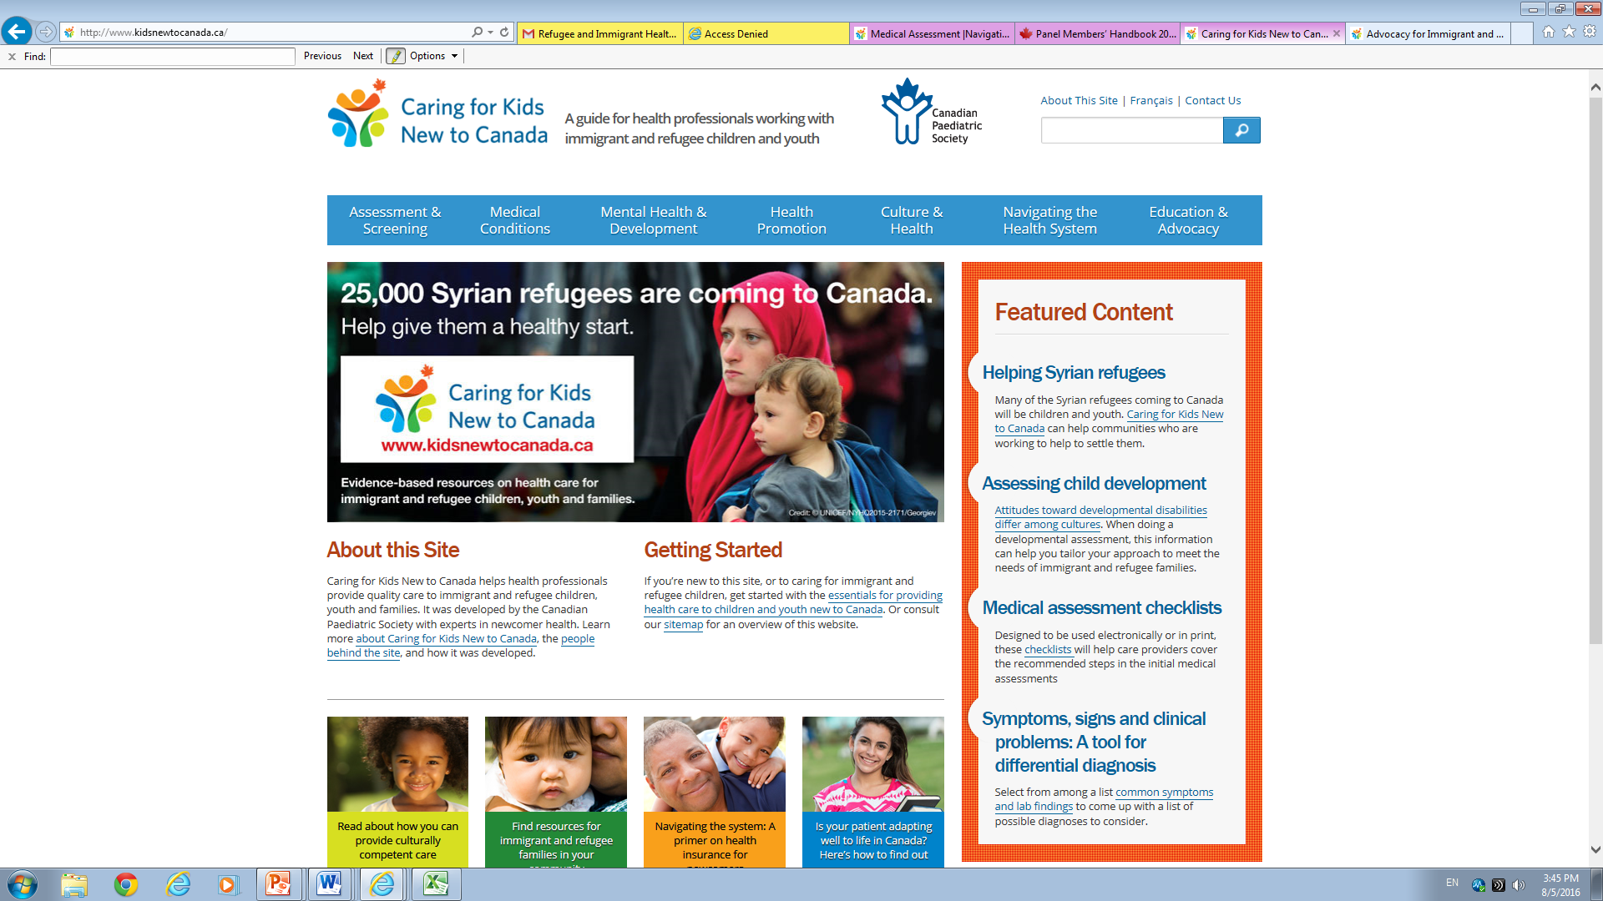
Caring for Kids New to Canada
Notes:
this online resource provides an up to date guide for health care professionals caring for immigrant and refugee children
It is a practical tool with information on assessment and screening, medical condtions, and mental health of children new to Canada
Much of the informaiton provided in this presentaion is available on this website
Source:
Caring for Kids New to Canada
http://www.kidsnewtocanada.ca

Slide 28
Resources
Multicultural clinic
YMCA
CDAR/PRAIDA
Centre de services préventifs de Cote des Neiges
Action Refugiés Montréal
Maison d’Haiti
Baobab familial
Maison Bleu
www.kidsnewtocanada.ca

Slide 29
Children’s Without Borders
Multi-disciplinary advocacy group at the MCH
Promote and advocate for improved access to health care for immigrant, refugee, refugee claimant and non-status children
Activities:
Raise awareness among healthcare community
Create partnerships with front-line organizations
Advocate for policy changes to improve access for this vulnerable population

Slide 30
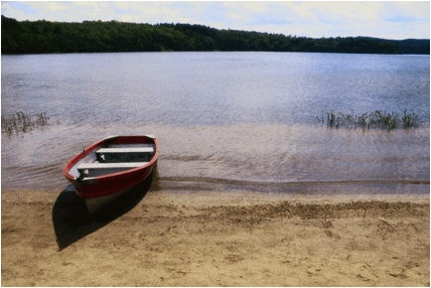
You have to understand, no one puts their children in
a boat unless the water is safer than the land
---- Warsan Shire (Somali-British poet)

Slide 31
Acknowledgements
Children’s Without Borders Grand Rounds March 2017 (Esli Osmanlliu, Patricia Li, Gillian Seidman, Samir Shaheen-Hussain)
Elisa Ruano Cea

