Slide 1
Access to Language and Health Literacy Options available to meet the language needs of recent arrivals and other minority language speakers at MUHC . Identification of gaps in services
Marie Serdynska, Coordinator,
Sociocultural Consultation and Interpretation Services – SCIS
Services de consultation Socioculturelle et d’interprétariat – SCSI
MCH, MUHC - HMÉ, CUSM
Member HPH International Network, Migration, Equity and Diversity Task Force membre, groupe de travail sur Migration, Equité et Diversité (MED)

Slide 2
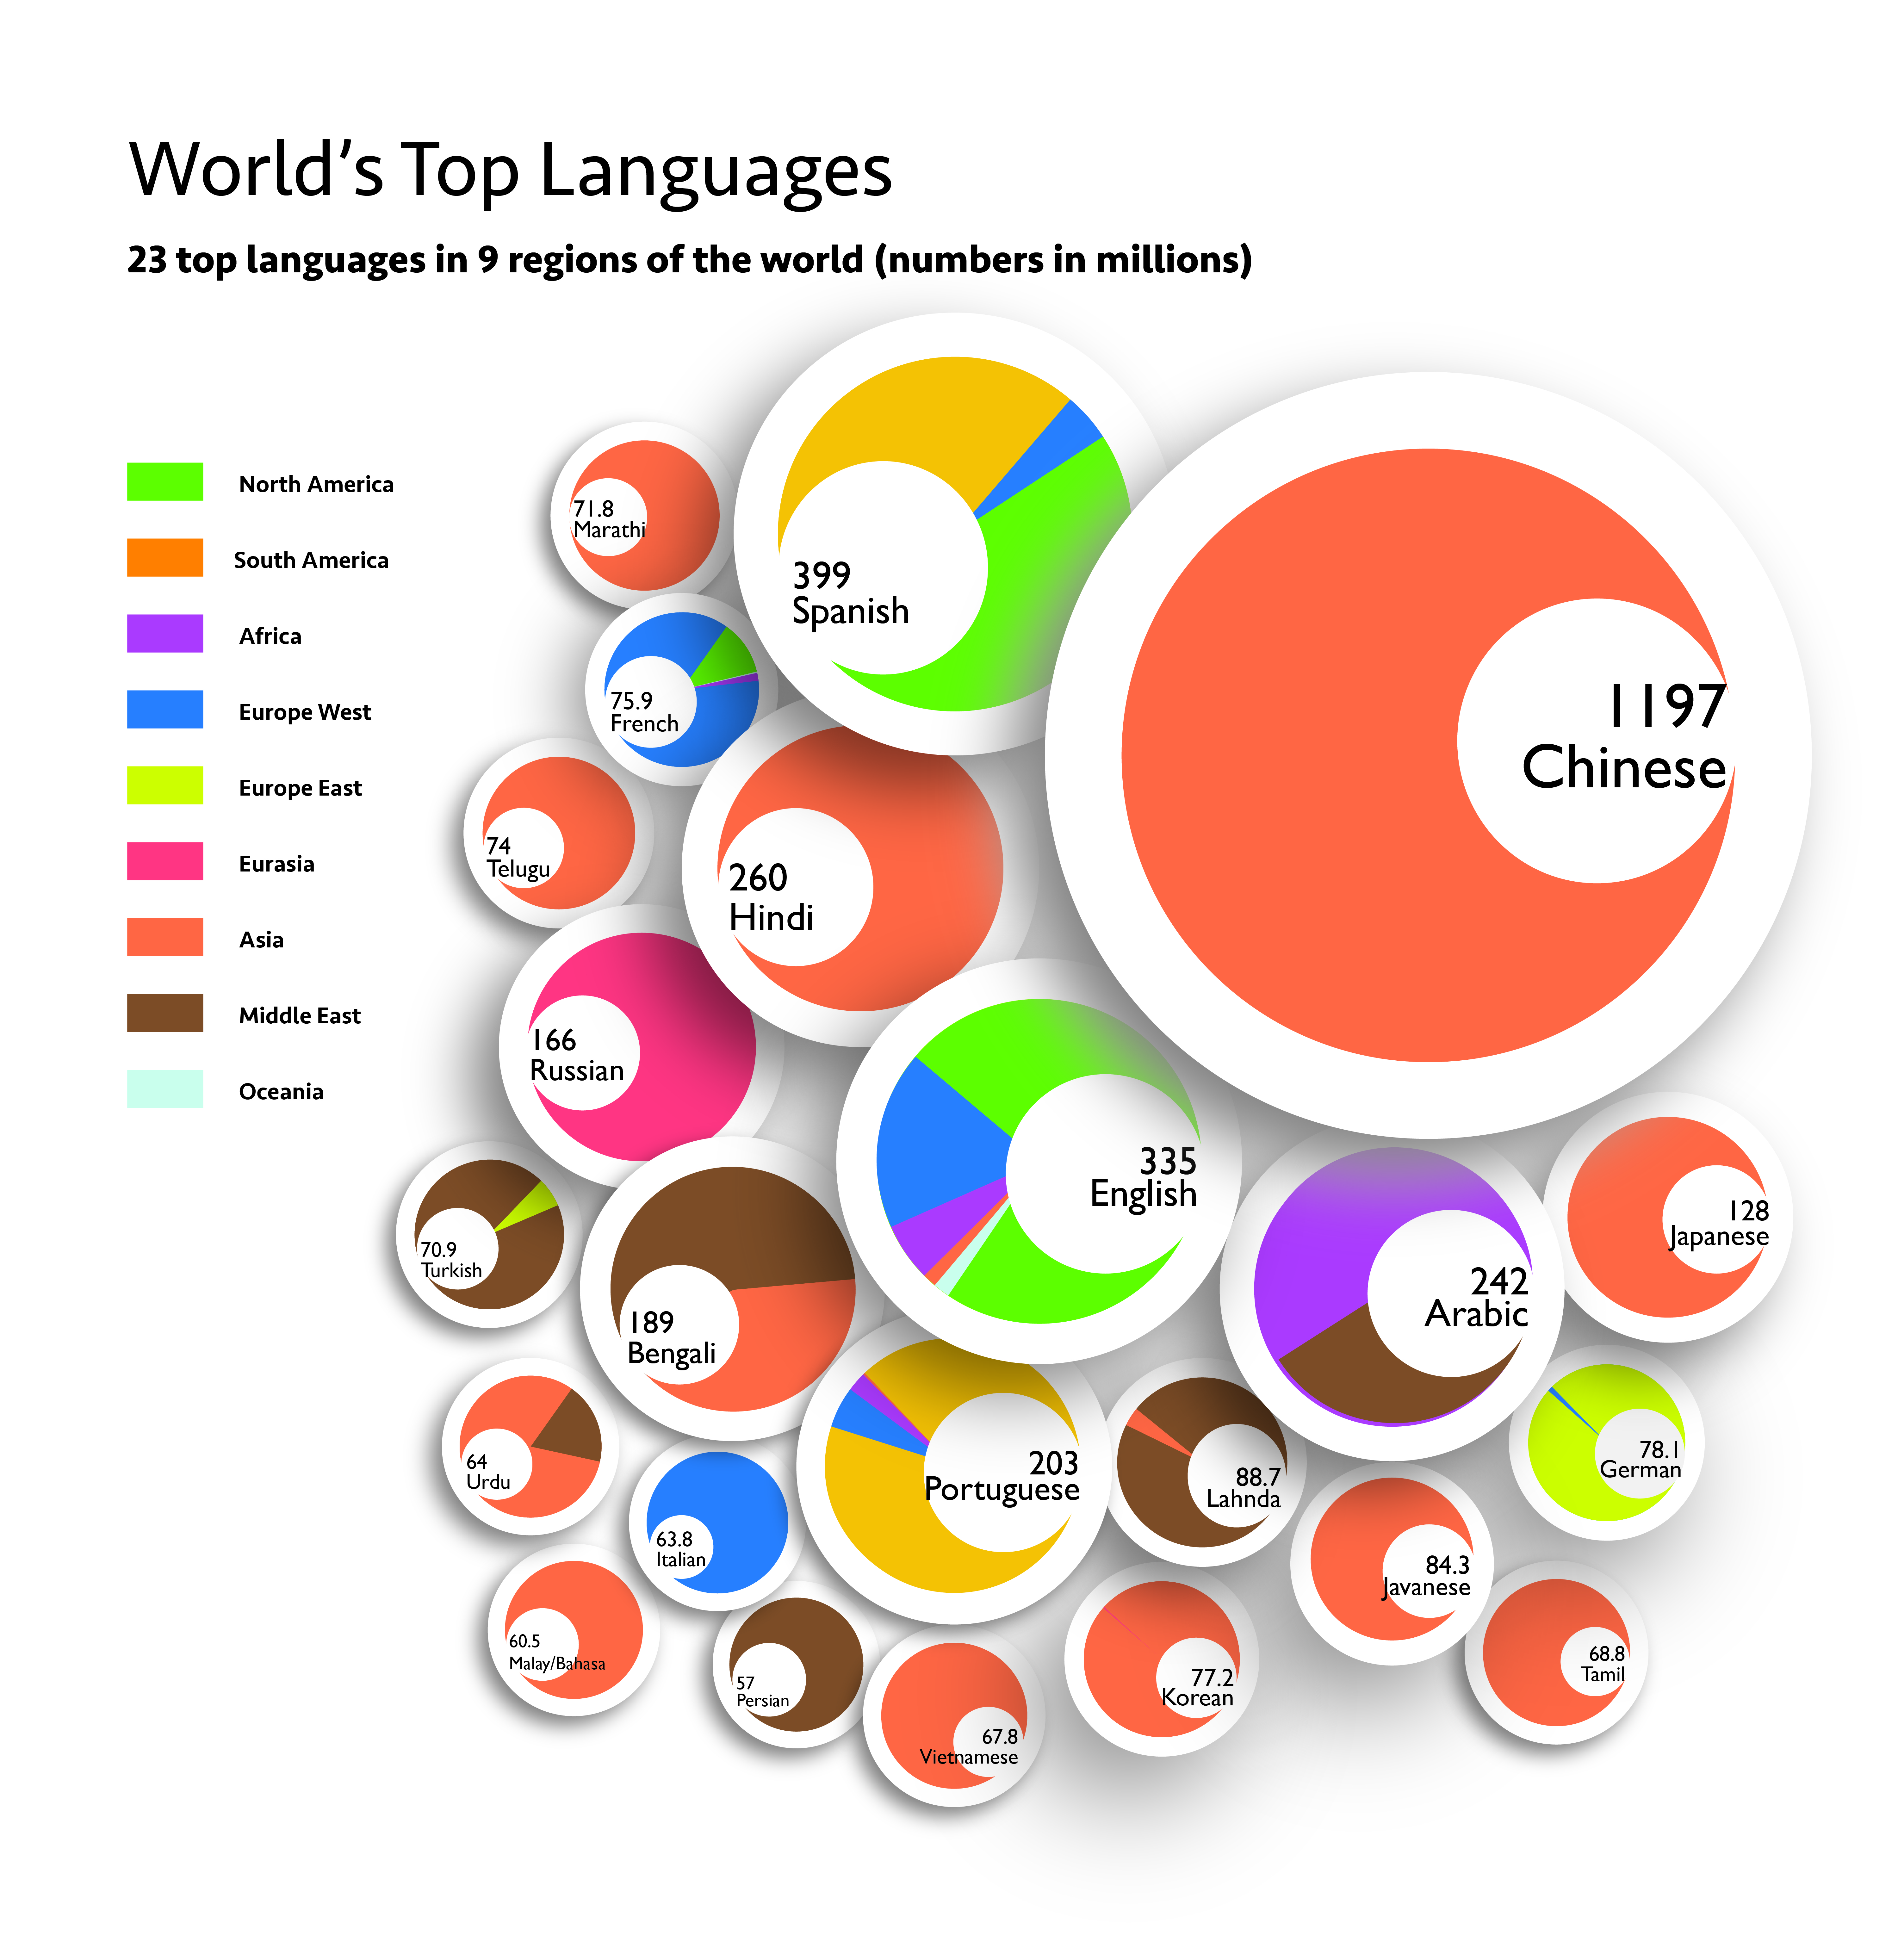
Edia Tsui
Adapted from Lopez:
South China Morning Post

Slide 3
Other Language Speakers
Global languages can surpass official languages and are spoken in multiple places
Language a determining factor in equitable access to healthcare
MUHC Mission: “ We relate to patients and their families in a transparent way that respects their dignity as well as their cultural and linguistic needs”
MCH Vision: “…..putting the needs of Quebec children and their families first and respecting the language and cultural sensitivities of those we serve”

Slide 4
Chinese Most Interpreted Language at MCH
4733 Interpretations 2016 – 2017
Chinese 36%

Slide 5
MUHC Language Interpretations Stats 2015-2016* as reported
MCH - SCIS | 5037
MCH Call Centre | 44
MGH Call Centre | 188
Lachine Call Centre | 1
RVH Call Centre | 158
Inuit Call Centre | 34
MUHC Call Centre Totals: | 425
BII – MUHC minus MCH** | 197
MUHC Interpretation Totals | 5659
MUHC Adult Sites Totals | 622
*Call Centre Stats counted from Jan-Dec. Others counted from Apr – Mar
** MCH interpretations carried out by The Banque inter-régionale d’interprètes total 51 and are counted in MCH SCIS stats

Slide 6
Chinese estimated most spoken language after French and English at MUHC Adult Sites
Based on recorded and anecdotal information
Need for systemized Interpreter services on adult Sites
Currently, paid Interpreters requested from Banque Interregionale d’interpretes for critical cases
Some Adult requests for paid Interpreters made through MCH SCIS (Psychiatry, Opthalmology)
SCIS Interpreters used by RVH Respiratory Medicine
Other adult sites interpretations on an ad-hoc basis

Slide 7
Indigenous Interpretations
Ullivik – Northern Quebec module
2 interpreters at The MGH and one each at The RVH and MCH
18 patients per day on average (2014)
Other:
Cree Patient Services
Mammat Innuat
Établissements\Périodes | 2012-13 | 2013-14
MTL CHEST | 118 | 118
MTL NEURO | 118 | 130
RVH | 2070 | 2229
MGH | 5146 | 5474
Lachine Hospital | 34 | 54
Douglas Hospital | 36 | 72
MCH | 1628 | 1639

Slide 8
Call Centre approaches to obtaining medical information
Emerging Trend in Healthcare
Medical questionnaires
Developmental assessments
Less relevant in other languages
Presence of trained HCP preferred
With Interpreter
Differences in cultural frames of references
Interpreters not always able to elicit full information without discussion with the clinician
Families without support networks to guide them in parenting and developmental milestones cannot always answer questions
Culturally relevant material in other languages required from clinical staff

Slide 9
Admissions of Resettled Refugees by Official Languages Spoken Preliminary Figures: January 2015 – July 2017
Resettled Refugees Canada | 84,355
Speak neither English nor French | 52,540 (62%) =
Resettled Refugees Quebec | 16,275
Speak neither English nor French | 8005 (49%) >
open.canada.ca/data/
Nov 15 – Nov 16 No F/E Canada 63% Qc 38%

Slide 10
Other language mother tongue spoken at at Home
1 in 4 Canadians speak another language at home
28% speak only their mother tongue at home
Includes Indigenous as well as Immigrant languages
Indigenous : Cree most spoken at home across Canada (different dialects) 83,985
Followed by Inuktitut 39,025
Mandarin most spoken non official language in Canada
Arabic most spoken language at home in Quebec
Mandarin in top five in Quebec
Preliminary date census 2016
Notes:
Cree dialects Atikamekw, Montagnais Innu etc.

Slide 11
Multiple Language and Cultural Health Education Sites
Aboutkidshealth | Pediatrics | http://www.aboutkidshealth.ca/En/HealthAZ/Multilingual/Pages/home.aspx
Amaze | Autism | http://www.amaze.org.au/discover/about-autism-spectrum-disorder/resources/
Cree Health Board | Varied | http://www.creehealth.org/cree-translations
Ethnomed | All | http://ethnomed.org/patient-education
Inuithealthmatters | Pregnancy etc. | http://inuithealthmatters.aboutkidshealth.ca/
Medline Plus | All | https://medlineplus.gov/languages/languages.html
Medline Plus | African Americans | https://medlineplus.gov/africanamericanhealth.html
DH (UK) | Emergency Phrases | http://webarchive.nationalarchives.gov.uk/20130105192116/http://www.dh.gov.uk/en/Publicationsandstatistics/Publications/PublicationsPolicyAndGuidance/DH_4073230
Unicef (UK) | Baby Friendly | https://www.unicef.org.uk/babyfriendly/baby-friendly-resources
RCH (AUS) | All | https://www.rch.org.au/immigranthealth/translated/Translated_resources
CAMH | Mental Health | http://www.camh.ca/en/hospital/health_information/Pages/information_in_other_languages.aspx
Notes:
Translations of In house documents preferred

Slide 12
Importance of Language and Cultural Intervention
Clinicians must address cultural and language barriers from the start: Which language are you most comfortable speaking?
More face to face interaction
Avoid over reliance on written information and assessments unless in mother tongue
More critical medical errors made in diagnosis with other language speakers
Cultural frames of reference are different
Language discrepancies can result in increased psychological stress, hampering communication
Complexity of discussions prevent patients/ families from advancing in addressing health issues
Language identification issues: Use translation apps and call an Interpreter service

Slide 13
Need for greater translation and adaptation of patient information
Comprehensive patient education collection MUHC
Wider range of other language translations required
MCH SLP’s* use other language tools** to evaluate children’s speech and elicit engaged responses 1
A health literacy survey with nurses on surgical teams indicated nurses would use educational material on infection control with patients
The majority requested the material in other languages. Chinese and Italian most requested
Recent research indicates that minority language patients with chronic illness and caregivers just get by and would like bilingual information (official language plus other)
Sylvie Lambert et al
* Speech and language Pathologists
**Communicative development Inventories
Intelligibility in Context scales : Caroline Erdos
Notes:
Patients/families were happy to have information on H1N1 in Tamil, Spanish and Chinese

Slide 14
Nia:wen, Merci,
Thank you, Grazie,
Takk skal du ha

